Slide 1
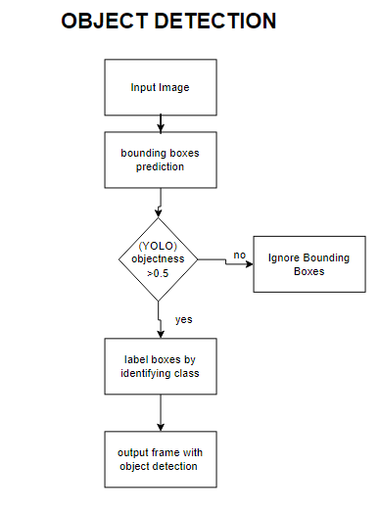

Slide 2
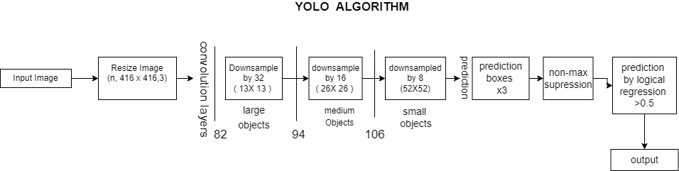

Slide 3
Yolo V3 Detection Process
Step1. Input the image and scale the image to the standard size (n, 416,416,3)
Step2. Divide the input image into 13*13, 26*26 52*52 grids of three scales. If the center point of an object falls in the grid unit, the grid unit predicts the object.
Step3. determine our bounding box priors on each grid unit. There are three clusters on each grid unit. Because of the three scales.
Step4. Input the image into the network for feature extraction. The model first produces a feature map of 13*13 on a small scale.
Step5. The 13*13 small-scale feature map is first subjected to convolutional set and 2 times upsampling, and then connected to the 26*26 feature map and output the prediction result.
Step6. the 26*26 feature map output by step5 is subjected to convolutional set and 2 times upsampling, then connected to the 52*52 feature map and output the prediction result.
Step7. from three scale predictive outputs, Afterward, using a probability score as a threshold to filter out most prediction with low scores.

Slide 4
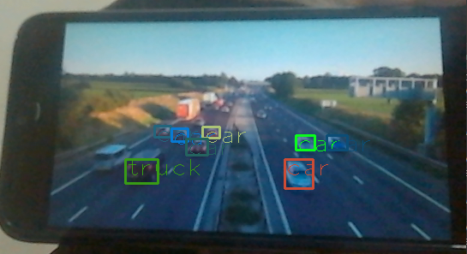
REALTIME OBJECT DETECTION
YOLO v3 can achieve real-time detection on the high-performance computer by means of the powerful computing capability of the GPU.
So, we have used Nvidia Jetson Nano (2GB) which has 128 CUDA cores Processor
Experimental results of a real-time detection

